Slide 1



Assessing VOIP Quality Deep Learning Approach Allen Ansari
Data Science Intensive Capstone Project, Sep 2020 Cohort
Thanks to Springboard Mentor
Blake Arensdorf, Amazon

Slide 2
Outline
The problem
Who might care?
Factors affecting Call Quality
Data Information
Data Wrangling
Data Exploration
Feature Extraction
Modeling
Conclusion

Slide 3


The Problem
MOS is expressed in one number, from 1 to 5, 1 being the worst and 5 the best
MOS is quite subjective, as it is based on figures that result from what is perceived by people during tests.
Need new method to predict MOS

Slide 4





Who might care?

Slide 5
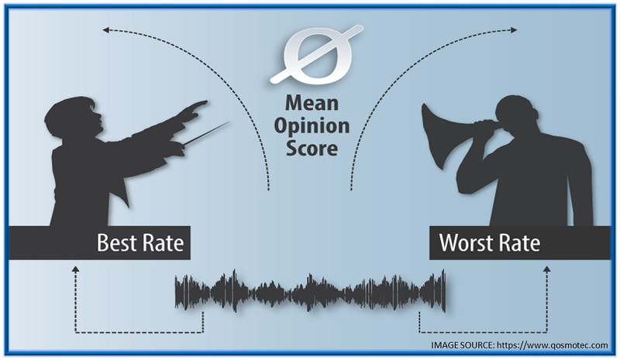
Factors affecting Call Quality
Packet Loss
Jitter
User experience
VoIP Codec
What About Audio Features?

Slide 6
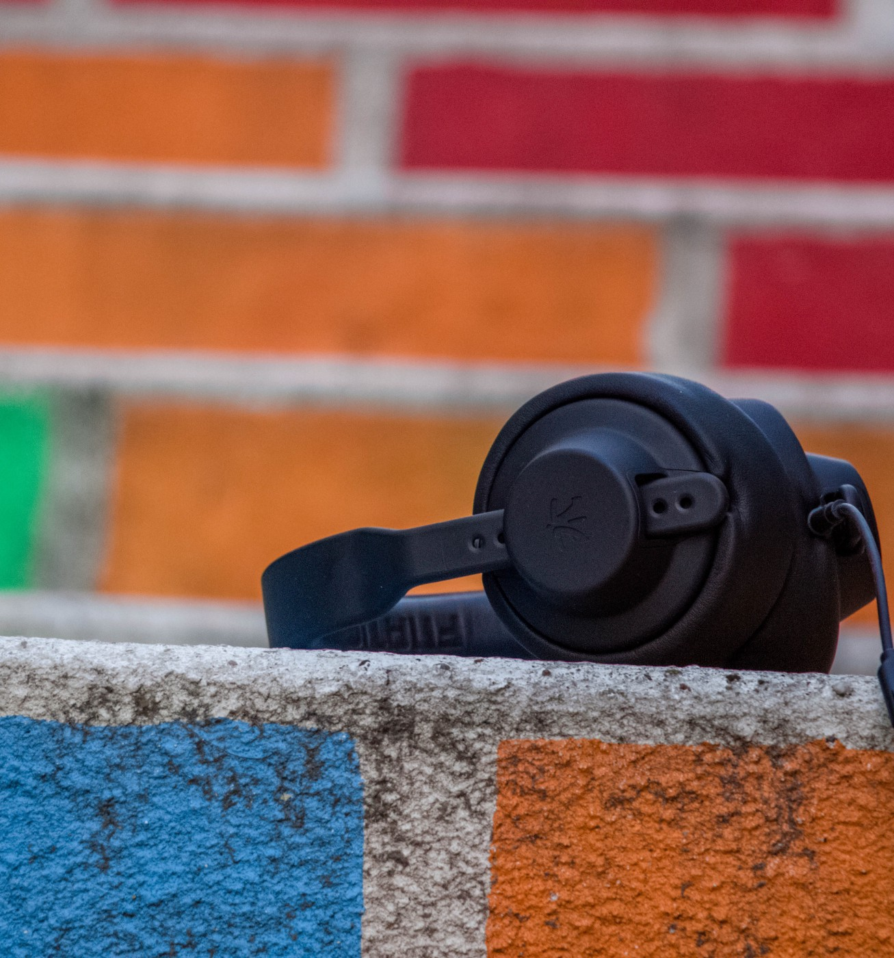
Data Information
opinion scores from 24 different listeners
84 audio files with two male and two female speakers
five types of commonly seen degradations

Slide 7
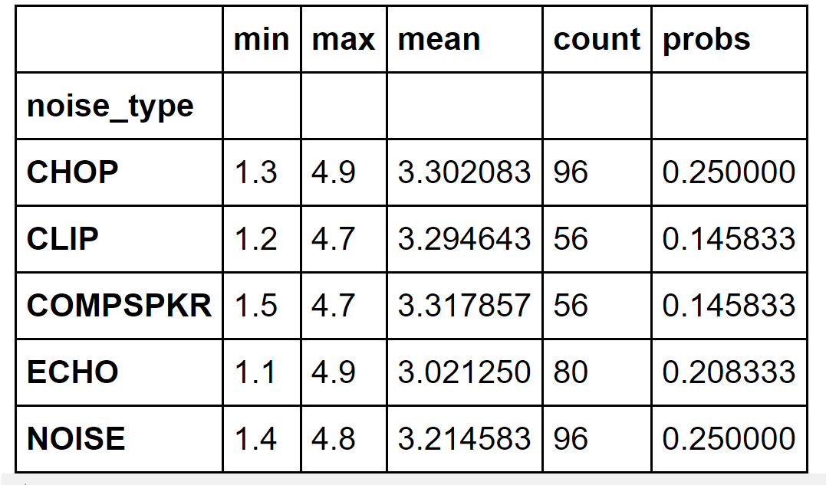
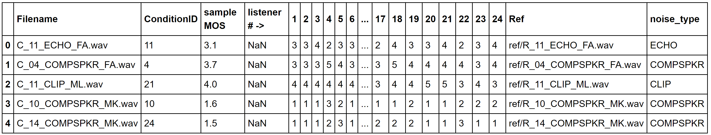
Data Wrangling

Slide 8
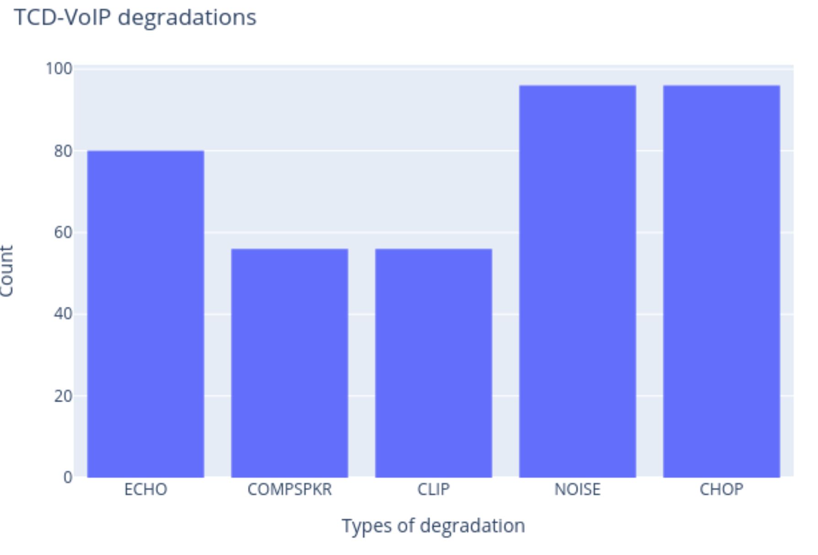
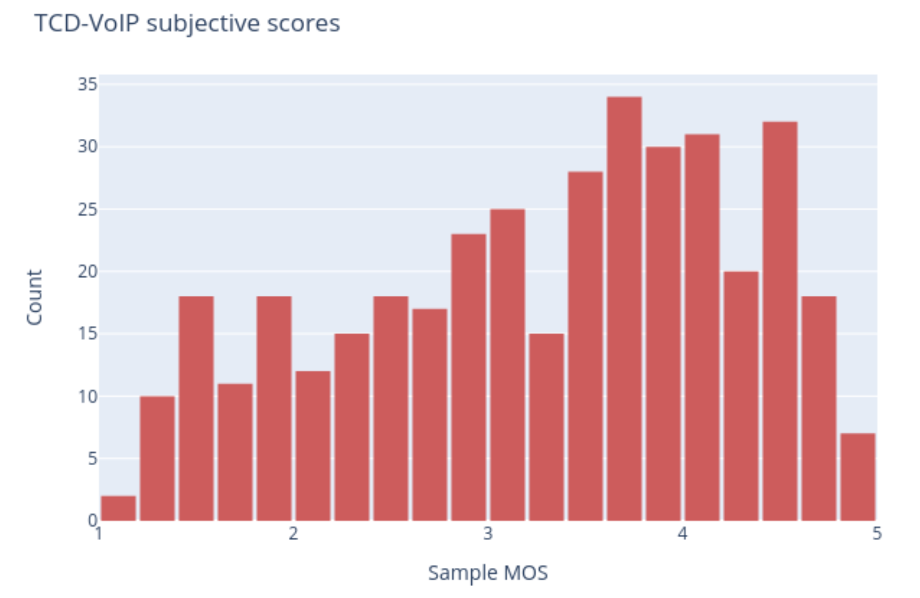
Data Exploration

Slide 9
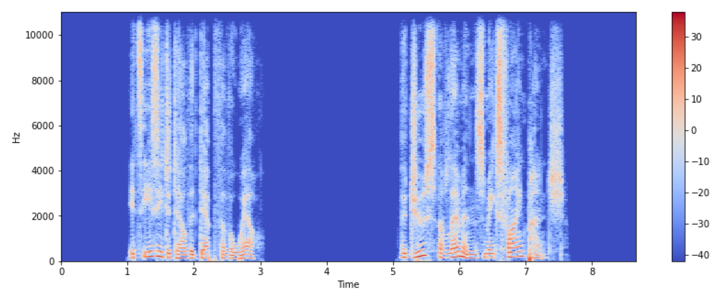
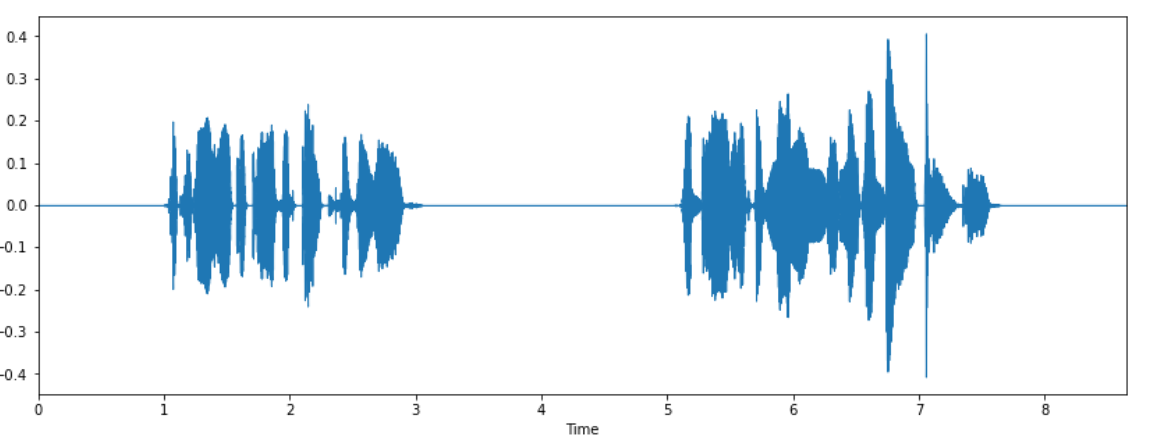
Data Exploration

Slide 10
Feature Extraction
The spectral magnitude of the STFT
The Spectrogram of the STFT
The Mel-Spectrogram
The Constant-Q transforms
The Mel Frequency Cepstral Coefficients (MFCCs)

Slide 11
Modeling
Convolution
Batch Normalization
ReLU
Max Pooling
Spatial Dropout

Slide 12
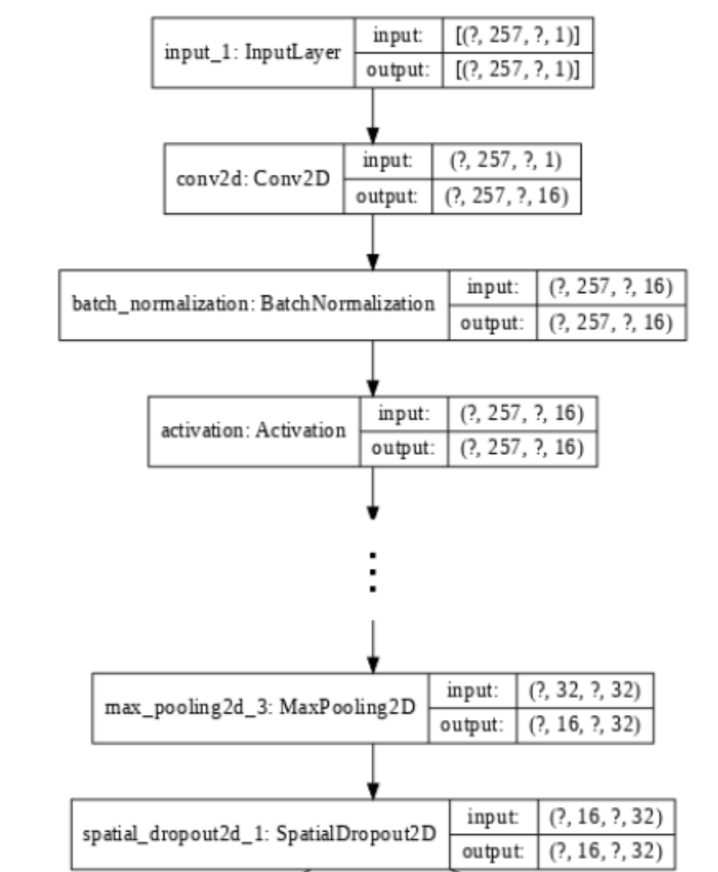
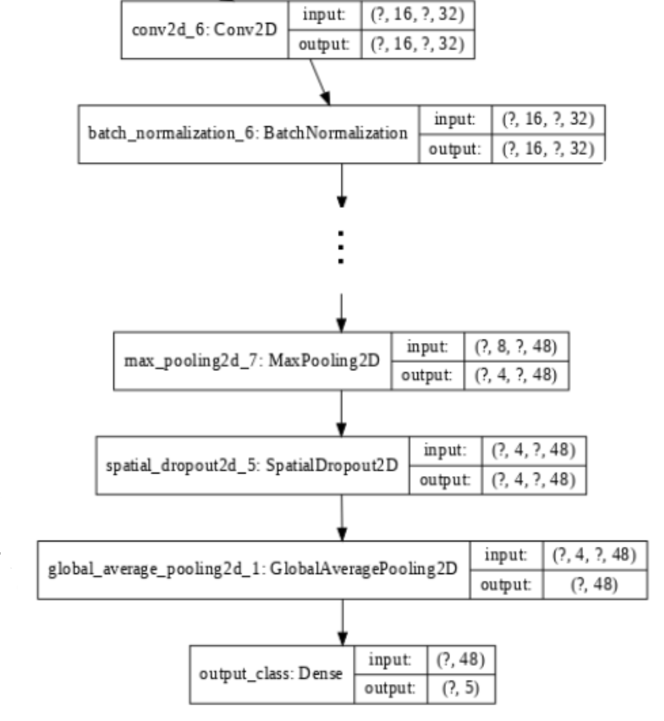
Model

Slide 13
Model
MODEL
The spectral magnitude of the STFT
0.4645
The Spectrogram of the STFT
0.9836
The Mel-Spectrogram
0.7443
The Constant-Q transforms
0.3922
The Mel Frequency Cepstral Coefficients (MFCCs)
0.8712

Slide 14
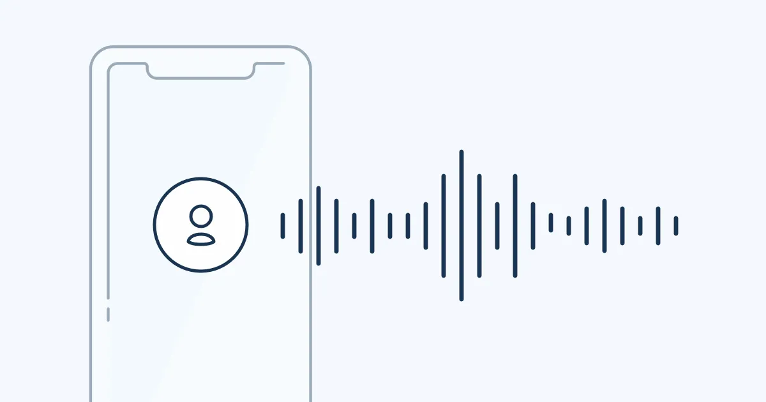
Conclusion
The Constant-Q transforms had better result
Larger data may help to reduce error
Having packet loss or jitter data improve the result

Slide 15
Thank You

